Slide 1

Big Data Modeling and Analysis Methods

Slide 2

目录
CONTENTS
01
Introduction to Big Data and Analysis Workflow
02
Big Data Modeling (Part I) — Supervised Learning
03
Big Data Modeling (Part II) — Unsupervised Learning & Deep Modeling
04
Integrated Project and Application Practice

Slide 3


Slide 4


YOUR LOGO
01
Introduction to Big Data and Analysis Workflow

Slide 5
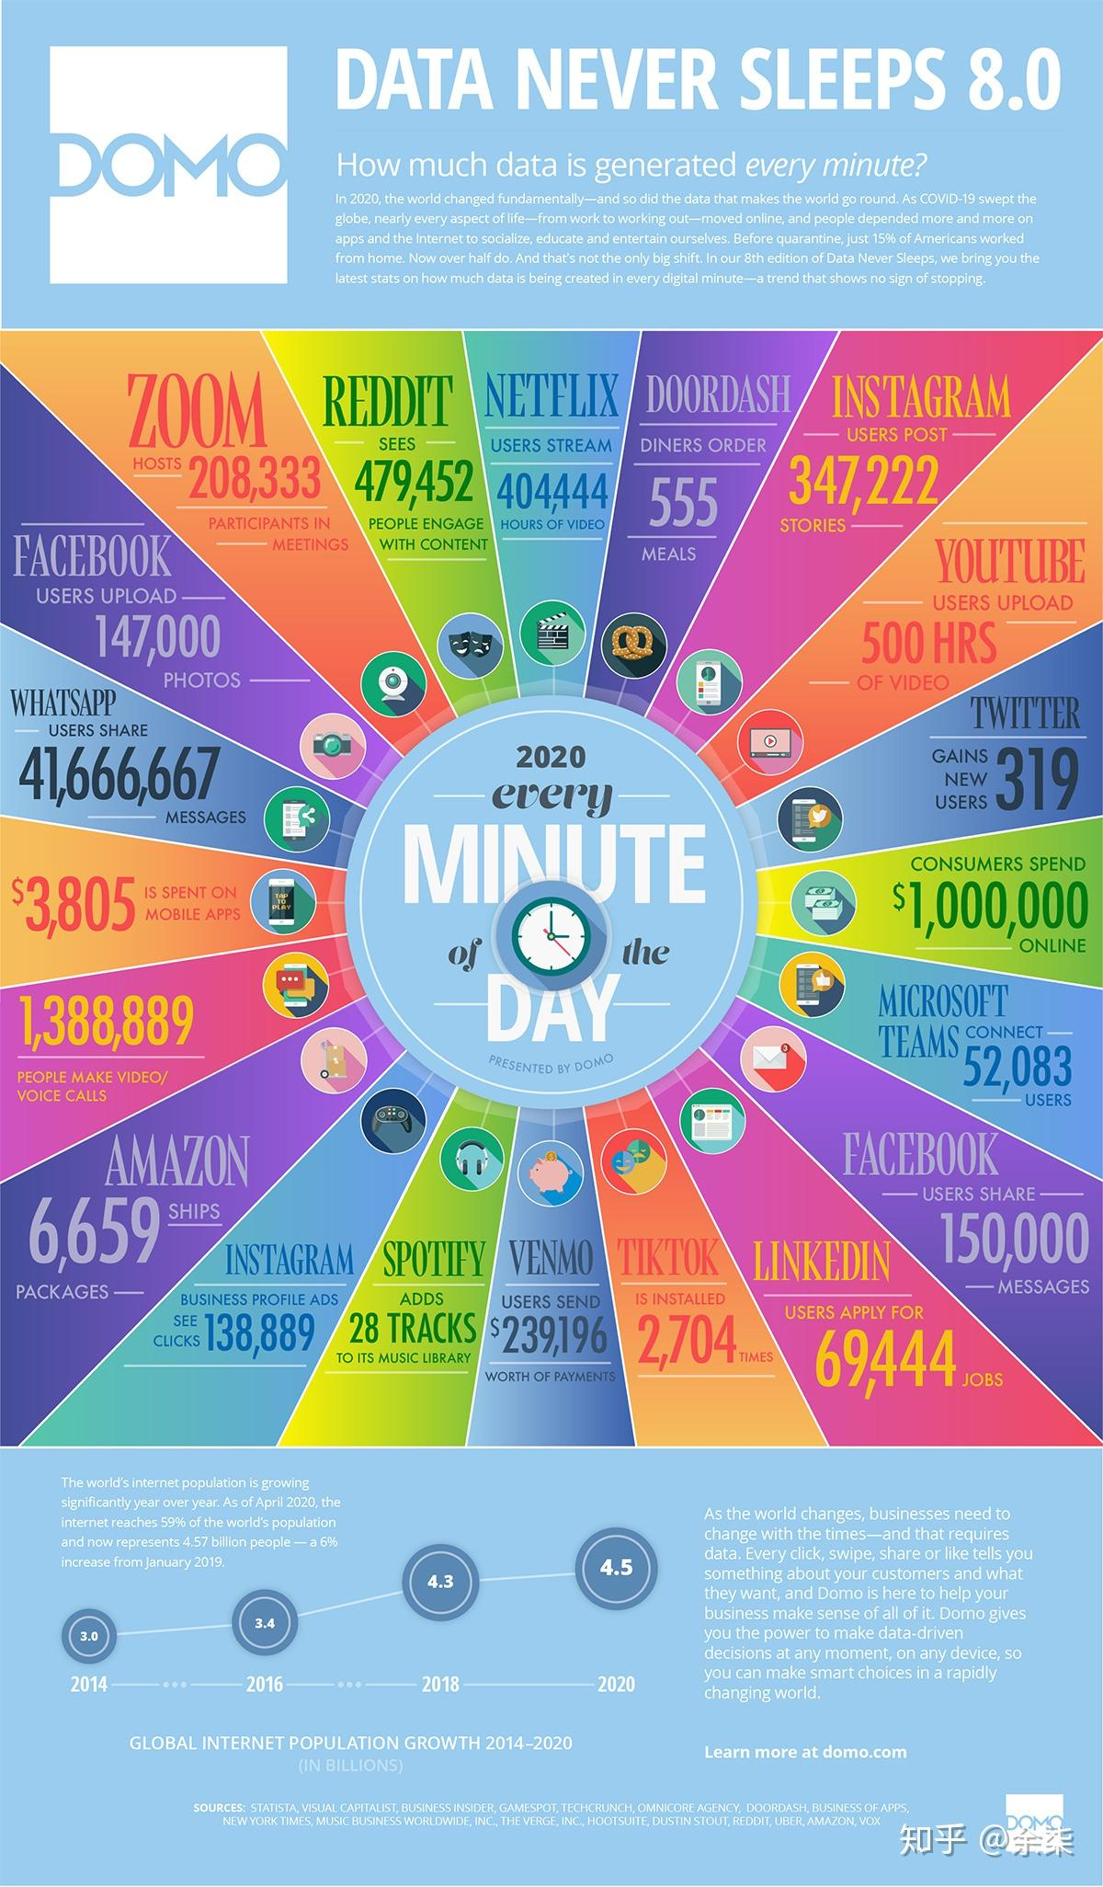
Introduction
Data Generated in One Internet Minute
How much data is generated every day?
What happens in a single minute on the internet — tweets sent, purchases made, videos streamed? How is all this data collected, analyzed, and turned into decisions?
Behind every smart recommendation or real-time alert is a massive data pipeline.
Today, we’ll explore how that pipeline works and what big data really means.

Slide 6


Definition and Characteristics of Big Data
📱 Definition and Characteristics of Big Data — The 5Vs
Volume: Huge size — terabytes, petabytes, or more.
Velocity: Speed at which data is generated (e.g., real-time trading).
Variety: Structured, semi-structured (JSON), and unstructured (images, video, text).
Veracity: Data uncertainty and quality issues.
Value: Low-value density — useful insight is often buried under noise.ty)

Slide 7
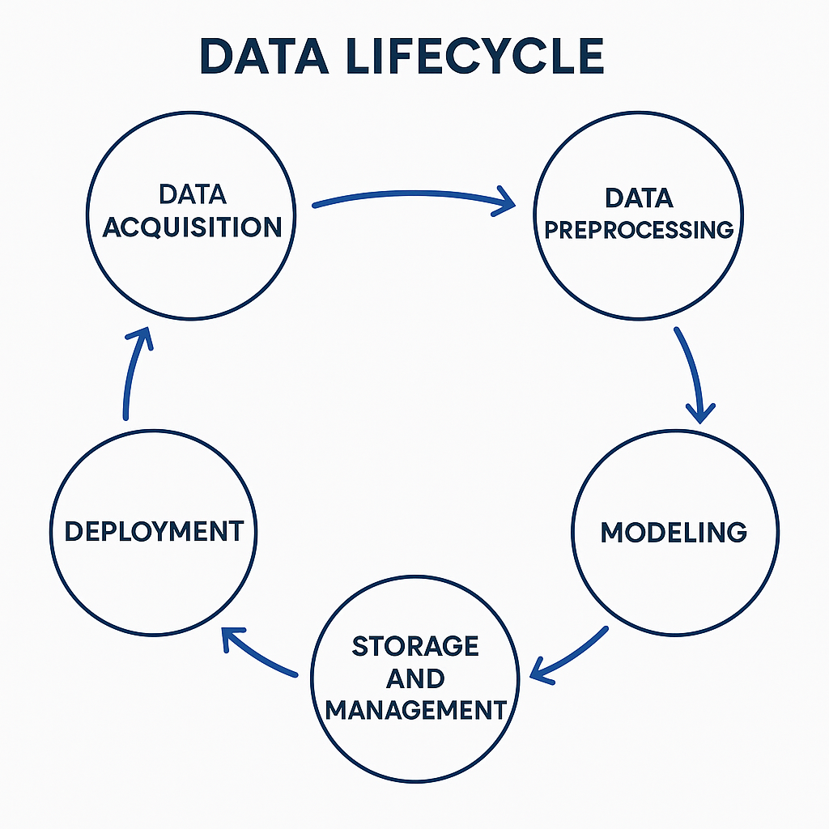
​​Big Data Analysis Workflow
Explain the six key stages in a typical big data analysis pipeline:
Data Acquisition: APIs, log files, sensors, crawlers.
Data Preprocessing: Cleaning, deduplication, missing value handling, feature extraction.
Storage and Management: Distributed storage systems (HDFS), NoSQL databases.
Modeling: Applying appropriate machine learning/statistical models.
Evaluation: Using metrics like accuracy, AUC, F1-score, cross-validation.
Deployment: Model integration into production (e.g., via APIs or dashboards).

Slide 8
Big Data vs. Traditional Analytics
✅ 1. Data Scale
Traditional analysis typically handles small to moderate volumes of structured data (e.g., spreadsheets, relational databases in the GB range).
Big data analysis deals with massive datasets (TB, PB, or even EB), often too large to fit on a single machine.
✅ 2. Technology Architecture
Traditional analysis relies on single-machine computation using tools like Excel, SPSS, or MySQL.
Big data analysis uses distributed computing architectures such as Hadoop and Spark, which enable parallel processing across multiple nodes.

Slide 9
Big Data vs. Traditional Analytics
✅ 3.Data Variety
Traditional analytics mostly involves structured data in tabular form.
Big data analytics must handle diverse data types: structured, semi-structured (e.g., JSON, XML), and unstructured (e.g., text, images, videos, logs).
✅ 4. Analytical Goals and Methods
Traditional analysis emphasizes accurate modeling, statistical inference, and hypothesis testing.
Big data analysis focuses more on pattern discovery, prediction, and real-time insight, often using machine learning and large-scale automation.

Slide 10
Big Data vs. Traditional Analytics
✅ 5. Computing Resources
Traditional analysis is limited by memory and CPU of a single machine.
Big data platforms can scale horizontally, adding more servers to increase processing power and storage.

Slide 11
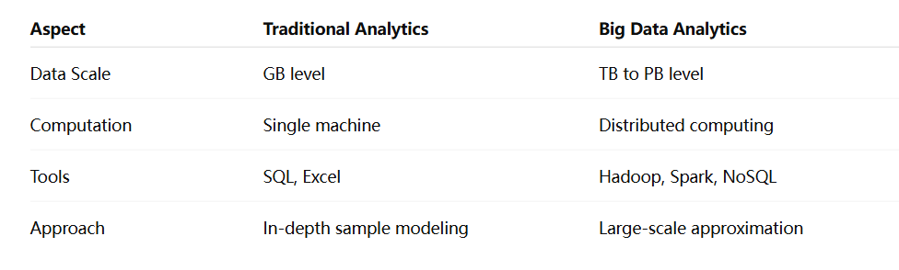
​​Big Data vs. Traditional Analytics

Slide 12

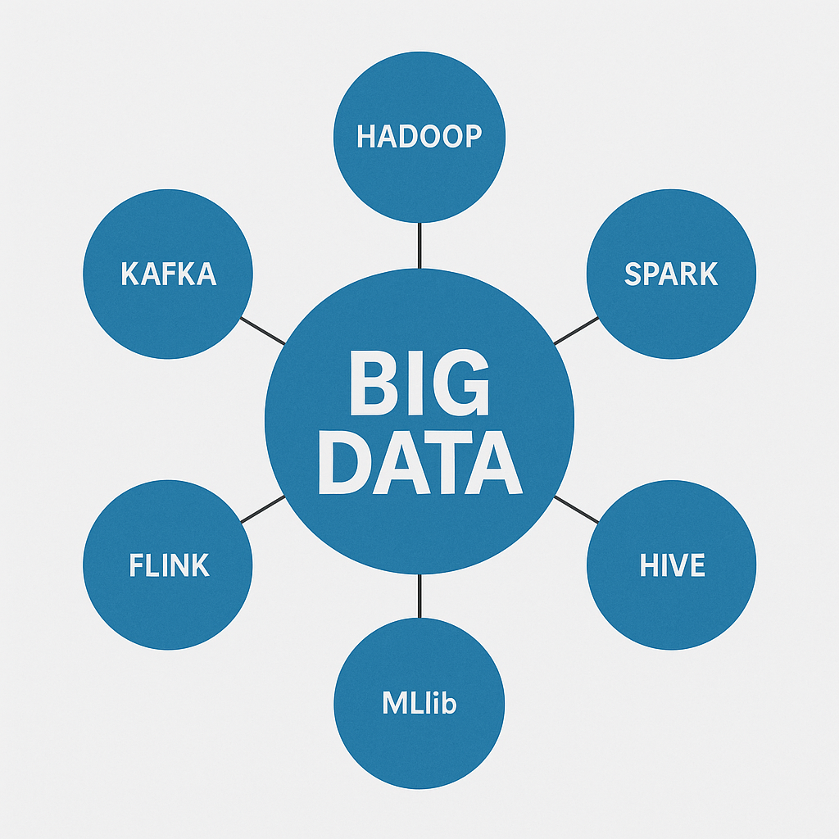
Overview of Big Data Technology Ecosystem
Hadoop: Legacy platform (MapReduce + HDFS).
Spark: In-memory computation, suited for ML.
Hive / Presto: SQL-like engines for querying big data.
Kafka / Flink: Real-time data processing.
MLlib / Mahout: Distributed machine learning libraries.

Slide 13
YOUR LOGO
02
Big Data Modeling (Part I) — Supervised Learning

Slide 14
​​Supervised Learning
🧠 “How does Amazon recommend what you might want to buy?”
🧠 How do banks detect whether a transaction might be fraudulent?
Behind these intelligent systems is a powerful machine learning technique called supervised learning. Give me labeled data, and I’ll learn to predict the future

Slide 15
​​Supervised Learning: Basic Concept
📱 Basic Concept
Supervised learning is a type of machine learning where the model is trained using labeled data — that is, each input is paired with a known output.
The goal is for the model to learn a mapping from inputs to outputs so it can predict outcomes for new, unseen data.
📱 Example:
Given historical housing data (with features like area and number of rooms, and known prices), a supervised learning model can learn to predict the price of a new house.

Slide 16
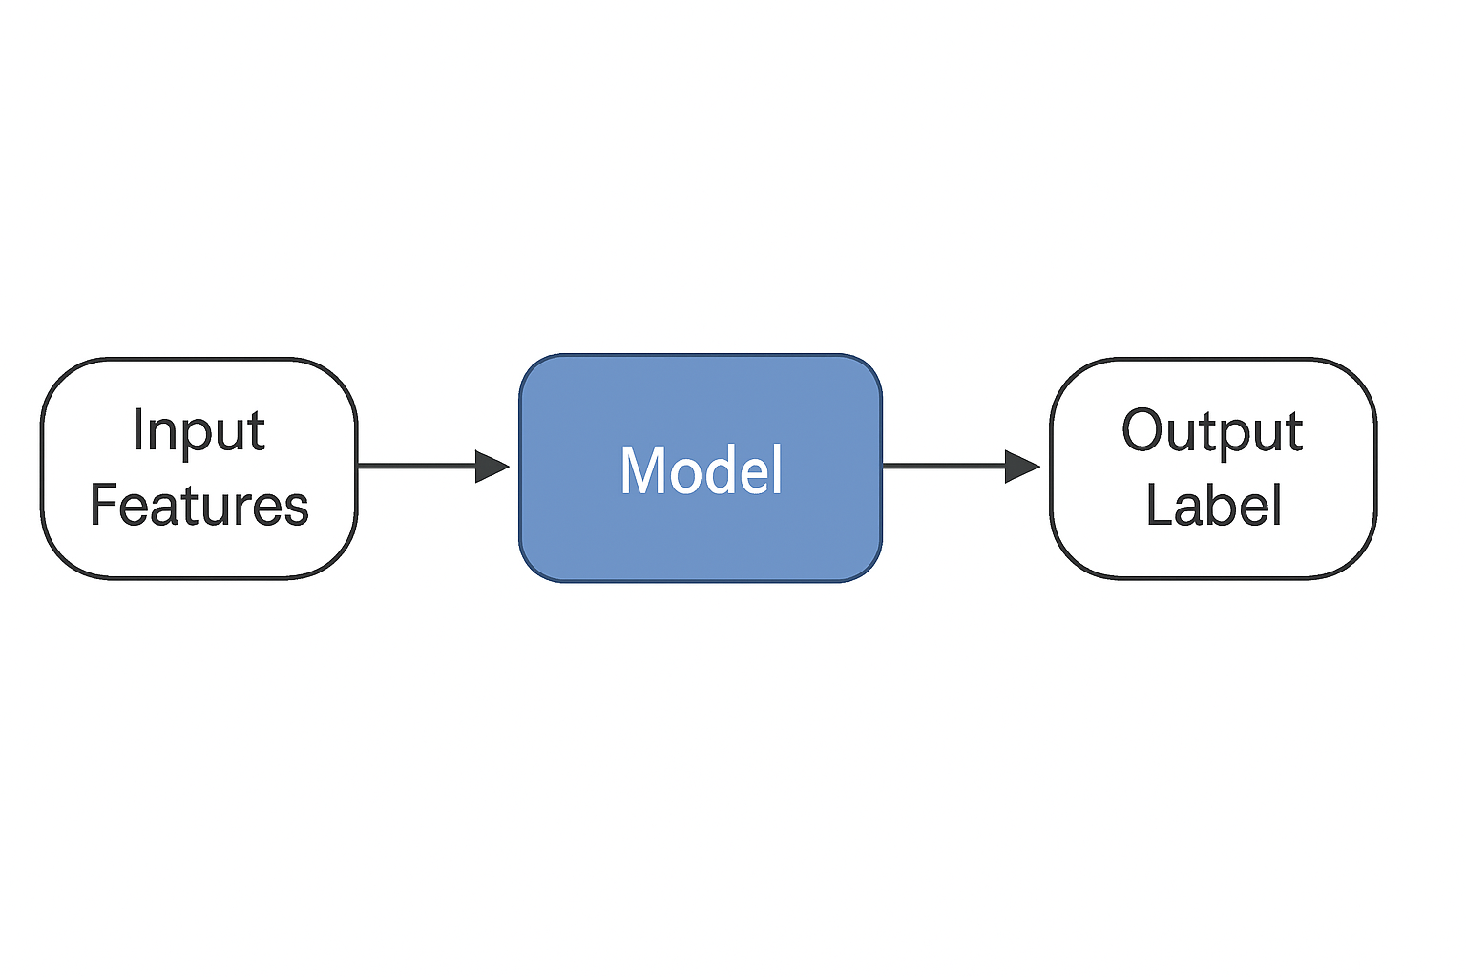
​​Typical Workflow of Supervised Learning
1.Data Preparation
Input data consists of features (X) and labels (Y)
Example:
X = [age, gender, purchase history]
Y = [clicked / not clicked]
2.Train/Test Split
The dataset is divided into a training set (to build the model) and a test set (to evaluate it).
3.Model Training
The algorithm learns a function that maps inputs (X) to outputs (Y).
4.Prediction
The trained model is used to make predictions on new or unseen data.
5.Evaluation
The model's performance is assessed using metrics such as accuracy, precision, recall, or RMSE, depending on the task type.

Slide 17
Challenges and Strategies in Big Data Modeling
In traditional machine learning, we usually work with manageable datasets. But once we enter the realm of big data, modeling becomes much more complex. Let's look at three key challenges — and how to deal with them
🧠 Challenge 1: Extremely Large Datasets — Slow and Costly Training
Problem: Training on millions or billions of records is too heavy for a single machine. Memory and time become bottlenecks.
Strategy: Use distributed computing frameworks (e.g., Spark MLlib, distributed XGBoost) to parallelize the training process across multiple nodes.

Slide 18
Challenges and Strategies in Big Data Modeling
Challenge 2: High-Dimensional Features — Redundancy and Overfitting
Problem: High-dimensional data can slow down learning and lead to overfitting.
Strategy: Apply feature selection and dimensionality reduction, such as PCA, information gain, or L1 regularization, to improve efficiency and generalization.
Challenge 3: Low-Quality Data — Noise, Missing Values, and Label Errors
Problem: In real-world data, noise and missing values are common, and label errors can severely degrade model performance.
Strategy: Perform robust data preprocessing, including outlier detection, missing value imputation, and data filtering to improve data quality before modeling.

Slide 19
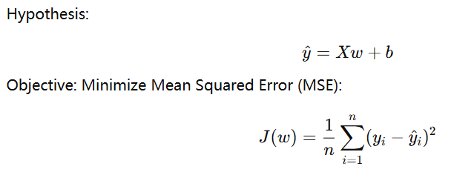
​​Common Supervised Learning Models
1.Linear Models
Linear models include linear regression and logistic regression
Linear Regression
In the Big Data Context:
Works well with high-dimensional, sparse data
Fast to train, easy to parallelize (e.g., with Spark MLlib)
High interpretability — each coefficient has a clear meaning

Slide 20

​​Common Supervised Learning Models
Logistic Regression
When to Use It:
Used for binary classification problems
Linear regression cannot output probabilities in [0,1], so logistic regression uses the sigmoid function:
Advantages & Limitations:
Pros:
Efficient and scalable
Produces probability outputs
Coefficients are interpretable
Cons:
Only models linear decision boundaries (can’t capture complex patterns)

Slide 21
​​Common Supervised Learning Models
Logistic Regression
When to Use It:
Used for binary classification problems
Linear regression cannot output probabilities in [0,1], so logistic regression uses the sigmoid function:
Advantages & Limitations:
Pros:
Efficient and scalable
Produces probability outputs
Coefficients are interpretable
Cons:
Only models linear decision boundaries (can’t capture complex patterns)

Slide 22
​​Common Supervised Learning Models
The linear model above is only suitable for linear models. What do we do with nonlinear tasks?------Tree Models and Ensemble Learning
Decision Trees – The Foundation
Key Concepts:
Recursive, rule-based partitioning of feature space
Internal nodes represent feature tests, leaves represent predicted output
Splitting Criteria:
Classification: Gini Index, Information Gain (Entropy)
Regression: Variance Reduction / MSE

Slide 23
​​Common Supervised Learning Models
One tree can be unstable and sensitive to data noise.
Random Forest (Bagging approach)
Gradient Boosting (XGBoost / LightGBM)
Build many decision trees on different bootstrapped datasets
At each split, randomly sample a subset of features (feature bagging)
Final prediction by majority vote (classification) or averaging (regression)
Sequentially builds trees
Each new tree corrects the residual errors from the previous trees
Final prediction is a weighted sum of all trees

Slide 24
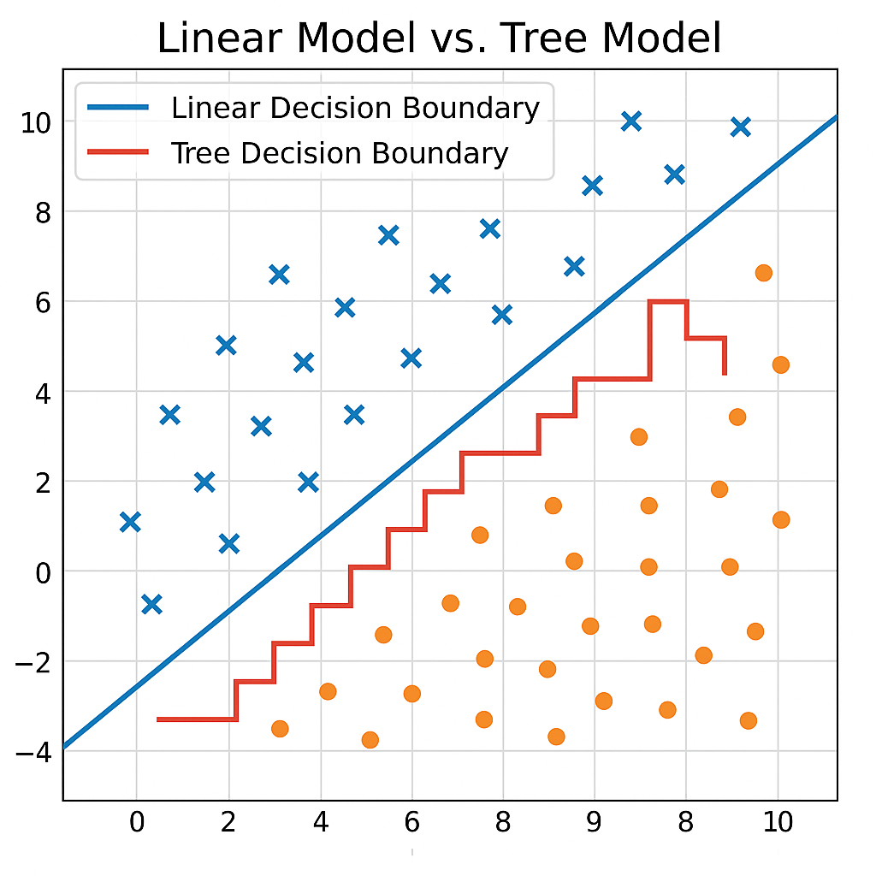
​​Common Supervised Learning Models
This image demonstrates how linear models and tree models (e.g., decision trees or random forests) differ in how they separate classes in a 2D feature space.
tree models are better suited for nonlinear tasks.
While linear models can only draw a single straight line, tree-based models can learn flexible, multi-region boundaries by combining many simple rules

Slide 25
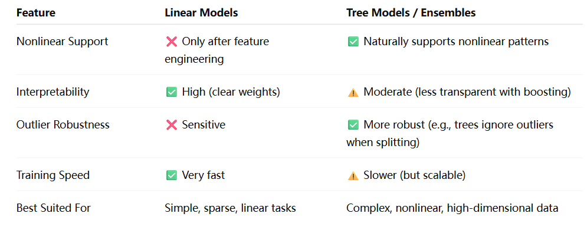
Common Supervised Learning Models

Slide 26
YOUR LOGO
03
Big Data Modeling (Part II) — Unsupervised Learning

Slide 27
Why is it important to study unsupervised learning and deep modeling?
The data we process is not always clearly labelled. In many real-world scenarios, the lack of labels is the norm.-----Supervised learning is not applicable
Examples:
Millions of retail transactions per day — but no ‘customer type’ labels
Web traffic logs — no tags indicating abnormal users
Medical imaging data — only a fraction are manually annotated by experts
Can a model uncover hidden patterns on its own?-----unsupervised learning

Slide 28
Definition & Characteristics of Unsupervised Learning
Definition:
Unsupervised learning refers to a class of machine learning algorithms that learn patterns and structures from unlabeled data, i.e., data without explicit output labels or targets.
The model tries to find hidden groupings, relationships, or representations purely based on the input features.
Key Characteristics:
No labels required: It works solely on input data without ground truth annotations.
Structure discovery: The goal is to uncover hidden structures like clusters, latent variables, or associations.
Exploratory nature: Often used for data exploration, feature extraction, or preprocessing rather than predictive tasks.
Lower interpretability: Results can be harder to validate or explain compared to supervised models.
Sensitivity to anomalies and novelties: Useful for outlier detection and identifying new, unseen patterns.

Slide 29
Common Clustering Algorithms
Clustering is the task of grouping similar data points together without any predefined labels.It’s like how humans naturally group animals into birds, mammals, reptiles — even without explicit instructions.
Real-world examples:
Grouping consumers into ‘price-sensitive’, ‘brand-loyal’, and ‘impulsive buyers’
Automatically categorizing news articles by topics (politics, sports, entertainment)
Clustering patient data to discover unknown disease subtypes

Slide 30
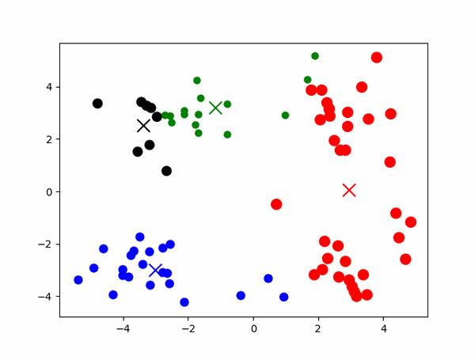
​​Threat Models
1.K-Means Clustering
Idea: Randomly initialize K centroids → assign samples → update centroids → iterate until convergence
Best for: Numerical data with roughly spherical clusters
Pros: Fast, scalable, widely used in big data
Cons: Requires predefined K, sensitive to initial points, affected by outliers

Slide 31
​​Threat Models
2.DBSCAN (Density-Based Spatial Clustering of Applications with Noise)
Idea: Dense regions of data form clusters; sparse areas are treated as noise
Best for: Arbitrary-shaped clusters, anomaly detection
Pros: Doesn’t need K; handles noise/outliers; discovers complex shapes
Cons: Sensitive to parameters (eps, minPts); less effective in high dimensions
📌 Use Case:
Cyberattack detection, fraud spotting, geospatial clustering

Slide 32
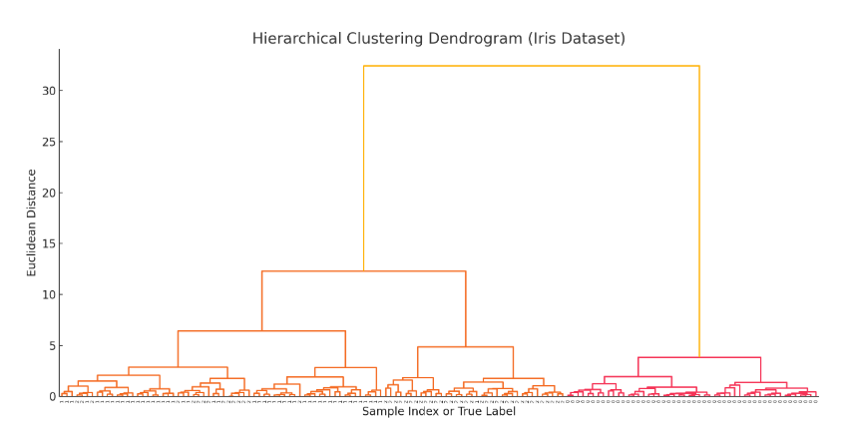
​​Threat Models
2. Hierarchical Clustering
Idea: Build a tree-like structure (dendrogram) by progressively merging or splitting clusters
Pros: No need to specify K; great visualization; reveals hierarchical structure
Cons: High computational cost for large datasets

Slide 33
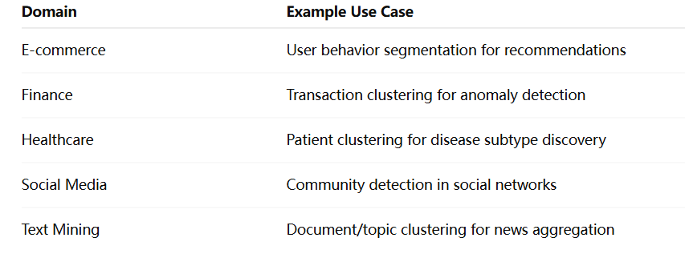
​​Applications of Clustering in Big Data

Slide 34
YOUR LOGO
04
Integrated Application and Project Practice

Slide 35
​​Big data modeling project in practice
Project Title: Supervised Learning-based Fraud Detection of Financial Transactions
Project Objectives
Design a machine learning model to identify potential fraud in credit card transactions to help financial institutions reduce losses and improve risk management capabilities.
Dataset Source:
Using the publicly available Kaggle dataset:
https://www.kaggle.com/datasets/mlg-ulb/creditcardfraud
Data Description:
Total sample size: 284,807
Fraudulent transactions: 492 (approx. 0.17%)
Number of features: 30 (most of them have been anonymized, such as V1~V28) + time and amount
Label Field: Class (0 for normal transactions, 1 for fraud)

Slide 36
​​Project Workflow Steps
Data Exploration & Preprocessing
Feature Engineering
Model Building & Training
Model Evaluation
Extract time-based features
Bucketize transaction amounts.
Remove highly correlated or redundant features.
Try models:
Logistic Regression
Random Forest
Examine class imbalance
Visualize features
Normalize Amount and Time
Use appropriate metrics for imbalanced data:
Precision, Recall, F1-score
ROC-AUC
Techniques:
5-fold cross-validation
Use balanced class weights
A code sample is shown below

Slide 37
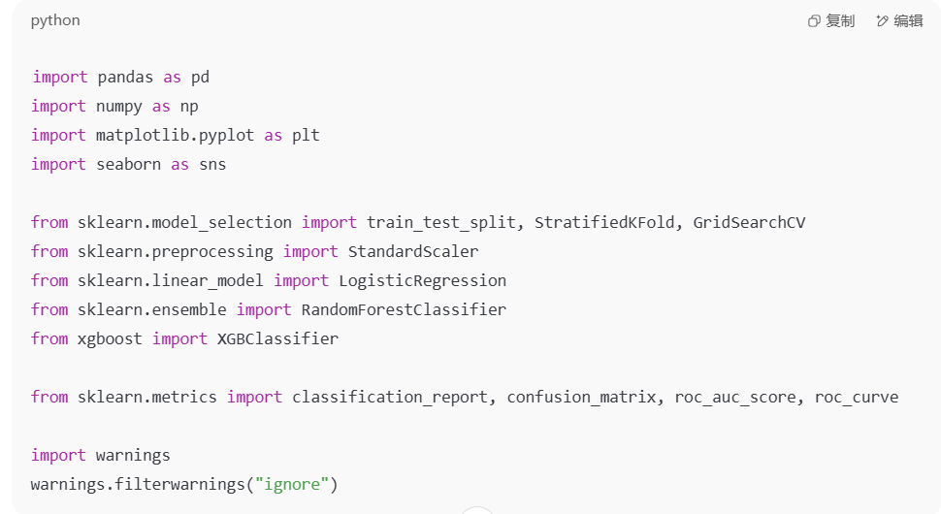
1: Import Required Libraries
pandas, numpy: for data handling and computation.
matplotlib, seaborn: for data visualization.
sklearn.model_selection: functions for splitting data and cross-validation.
StandardScaler: to normalize feature values.
Models: logistic regression, random forest, XGBoost.
sklearn.metrics: provides evaluation metrics (F1, AUC, etc.).
warnings: suppresses unnecessary output for cleaner logs.

Slide 38
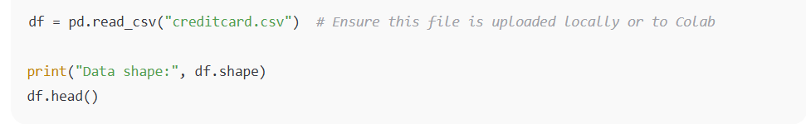
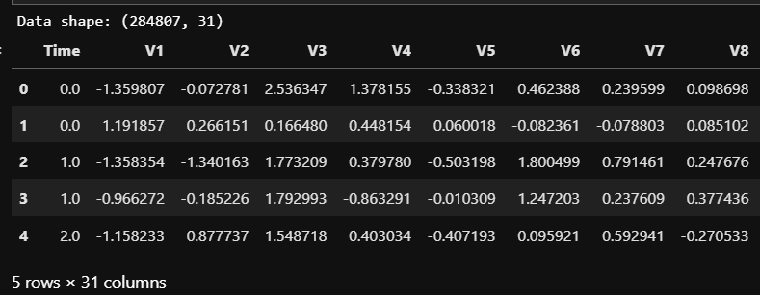
2: Load Dataset
Run the results：
pandas, numpy: for data Reads the dataset into a DataFrame.
df.shape shows the number of rows and columns.
df.head() displays the first 5 rows for preview.

Slide 39
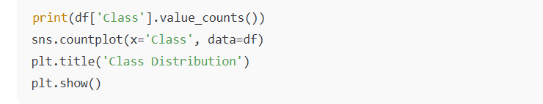
3.Check Class Imbalance
value_counts() shows how many fraud (1) vs. normal (0) transactions.
countplot() visualizes the class imbalance.
Fraud is extremely rare, which presents a major modeling challenge.

Slide 40
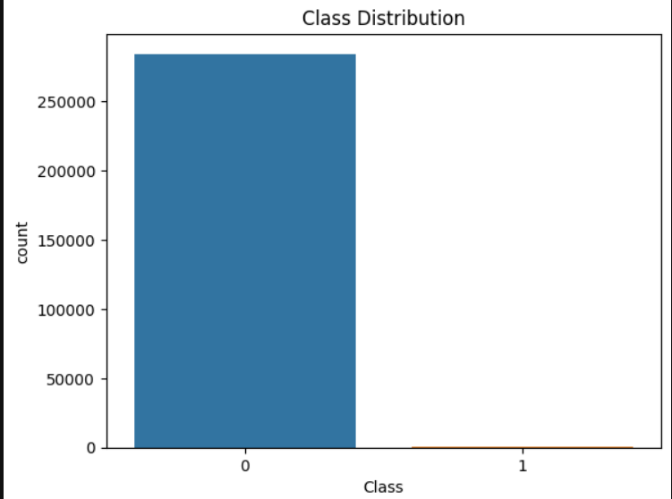

3.Check Class Imbalance
Run the results

Slide 41
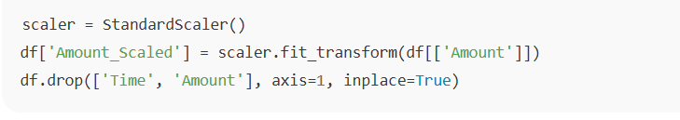
4.Feature Scaling
Scales the Amount feature to standard form (mean=0, std=1).
Scaling helps models like logistic regression perform better.
Removes Time and original Amount fields after transformation.

Slide 42

5: Train/Test Split
X: features, y: target label (fraud or not).
Splits data into 80% training, 20% test.
stratify=y: ensures both sets preserve fraud ratio.
random_state: ensures reproducibility.

Slide 43
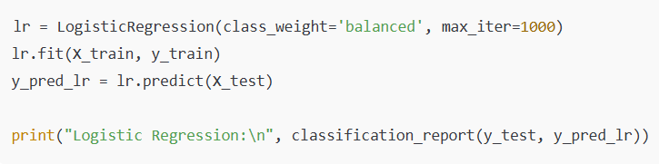
6: Train Logistic Regression
class_weight='balanced': auto-adjusts for class imbalance.
max_iter=1000: increases iterations to ensure convergence.
Trains the logistic regression model and prints evaluation metrics.

Slide 44
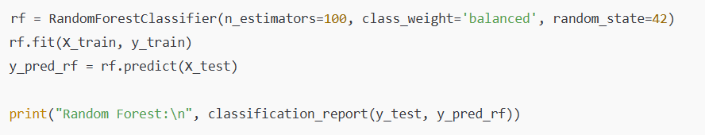
7: Train Random Forest
Uses 100 decision trees.
Also uses class weighting to handle imbalance.
Allows comparison with logistic regression performance.

Slide 45
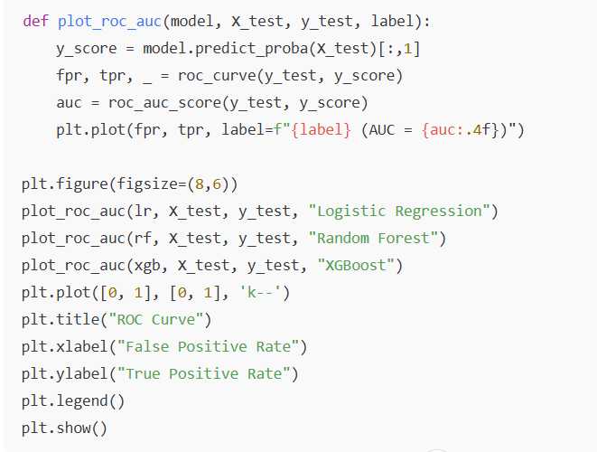
8: Plot ROC Curves and AUC
Draws ROC curves for each model.
AUC summarizes model ability to distinguish classes.
Ideal AUC is close to 1.0.
Helps compare model quality visually.

Slide 46
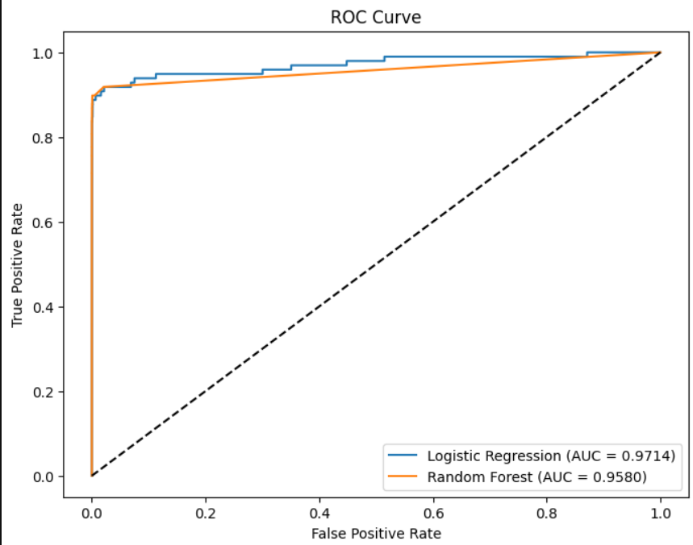
8: Plot ROC Curves and AUC
Run the results:
1.Both models perform very well
Both curves hug the top-left corner, which indicates:
High recall (most frauds detected)
Low false positive rate (few normal transactions wrongly flagged)
This means both models are strong classifiers in this imbalanced problem.

Slide 47
8: Plot ROC Curves and AUC
Run the results:
2. AUC Comparison
AUC (Area Under the Curve) measures the overall performance:
Logistic Regression: 0.9714
Random Forest: 0.9580
Closer to 1 means better discriminative ability.
Logistic Regression slightly outperforms Random Forest on this dataset.

Slide 48
THANK YOU

